Slide 1

Unit-1 Introduction to Data Mining (DM)
Data Mining (DM)
2101CS521
Prof. Jayesh D. vagadiya
Computer Engineering Department
jayesh.vagadiya@darshan.ac.in
9537133260

Slide 2

Looping
Topics to be covered
Motivation for Data Mining
Data Mining - Definition and Functionalities
Data Mining – On what kind of data?
KDD Process (Knowledge Discovery in Databases)
What Kinds of Patterns Can Be Mined?
Are All Patterns Interesting?
Issues in DM
Types of Attributes
Mean, Median, mode, Standard Deviation of Data
Data Matrix vs Dissimilarity Matrix
Dissimilarity of Numeric Data

Slide 3

Just think: One Second on Internet
9,003 Tweets
4,705 Skype Calls
1,711 Tumblr Posts
83,378 Google Searches
84,388 YouTube videos viewed
996 Instagram photos uploaded
& many more…
Are all these information is really important to us
?????????

Slide 4
Motivation: Why data mining?
“Necessity is the Mother of all Inventions”
“It has been estimated that the amount of information in the world doubles every 10 months.”
There is a tremendous increase in the amount of data recorded and stored on digital media as well as individual sources.
Since the 1960’s, database and information technology has been changed systematically from primitive file processing systems to powerful database systems.
The research and development in database systems since the 1970’s has led to the development of relational database systems.
“We are drowning in data, but starving for knowledge!”
“Data rich but Information poor”

Slide 5

Motivation: Why data mining? (Cont..)
Years | Evolutions
Since 1960’s | Data collection, database creation, IMS (hierarchical database system by IBM) and network DBMS
1970s | Relational data model, relational DBMS implementation
1980s | RDBMS, advanced data models, application-oriented DBMS (spatial, scientific, engineering, etc.)
1990s | Data mining, data warehousing, multimedia databases, and web databases
2000s | Stream data management and mining, Social Networks (Facebook, etc.), web technology (XML) and global information systems
At Present | Heterogeneous database systems, big data
Every day data grows exponentially,
but these all data are really important to us??

Slide 6
Motivation for Data Mining : An Example
Data → Knowledge → Action → Goal
Netflix collects user ratings of movies (data) → What types of movies you will like (knowledge) → Recommend new movies to you (action) → Users stay with Netflix (goal)
Gene sequences of cancer patients (data) → Which genes lead to cancer? (knowledge) → Appropriate treatment (action) → Save life (goal)
Road traffic (data) → Which road is likely to be congested? (knowledge) → Suggest better routes to drivers (action) → Save time and energy (goal)
Summary
The overall goal of the data mining process is to extract information from a large data sets or databases and transform it into an understandable structure for further use.

Slide 7
What is Data Mining?
Data mining refers to extracting or “mining” knowledge from large amounts of data.
“Knowledge mining from data” or “Knowledge mining”
“Extract knowledge from large data or databases”
“Knowledge discovery from database (KDD)”
Data Mining
Database Technology
Statistics
Machine Learning
Visualization
Other Disciplines
Information Science

Slide 8
What is Data Mining? Definition 2
The process of automatically discovering useful information from large data repositories
Data
Preprocessing
Data
Mining
Post
Processing
Data Input
Information
Feature Selection
Dimensionality Reduction
Normalization
Data Subsetting
Filtering Patterns
Visualization
Pattern Interpretation

Slide 9
Data Mining Architecture
Graphical User Interface
Pattern Evaluation
Knowledge Base
Data Mining Engine
Database or Data Warehouse Server
Cleaning, Integration & Selection
Database
Data Warehouse
WWW
Other Info Repositories

Slide 10
KDD (Knowledge Discovery in Databases) Process
Knowledge discovery in databases is a process of an iterative sequence of the following steps:
Selection
Preprocessing
Transformation
Data Mining
Pattern Evaluation
User Interface (Visualization of Pattern or Knowledge)

Slide 11





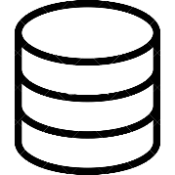
KDD (Knowledge Discovery in Databases) Process (Cont..)
Appropriate for mining by performing summary or aggregation operations, for instance.
Intelligent methods are applied in order to extract data patterns.
Pattern Evaluation
Patterns
The analysis task are retrieved from the database.
To remove noise and inconsistent data.
Data Mining
Knowledge
KDD Process
Transformation
Transformed Data
Preprocessing
Visualization and knowledge representation techniques are used to present the mined knowledge to the user.
Selection
Preprocessed Data
Target Data

Slide 12
KDD (Knowledge Discovery in Databases) Process (Cont..)
Data Selection: Where data relevant to the analysis task are retrieved from the database.
Data Cleaning: To remove noise and inconsistent data.
Data Integration: Where multiple data sources may be combined.
Data Transformation: Where data are transformed or consolidated into appropriate forms for mining by performing summary or aggregation operations.
Data Mining: An essential process where intelligent methods are applied in order to extract data patterns.
Pattern Evaluation: To identify the truly interesting patterns representing knowledge based on some interestingness measures.
Knowledge Presentation: Where visualization and knowledge representation techniques are used to present the mined knowledge to the user.

Slide 13
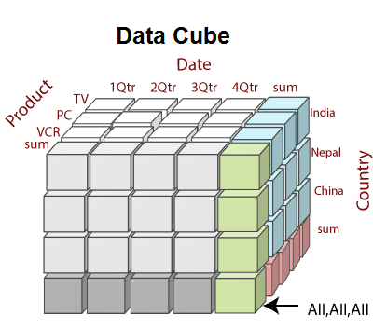
Data Mining—On what kind of data?
Relational Databases:
A database system, also called a database management system (DBMS), consists of a collection of interrelated data, known as a database tables, and a set of software programs to manage and access these data.
E.g. : SQL Server, Oracle etc.
Data Warehouses:
A data warehouse is a repository of information collected from multiple sources.
It is constructed after pre-processing of data. (Data cleaning, Data integration, Data transformation, Data loading, and Periodic data refreshing etc.)
E.g. : Stock Market, D-Mart, Big Bazar etc.

Slide 14
Data Mining—On what kind of data? (Cont..)
Transactional Databases:
Transactional database consists of a file where each record represents a transaction.
A transaction typically includes a unique transaction identity number (TID) and a list of the items making up the transaction (such as items purchased in a store).
E.g. : Online shopping on Flipkart, Amazon etc.
Other Data/Databases
Spatial data (Maps or Location related data)
Engineering design data (Designs of Buildings, Offices Structures data)
Hypertext and multimedia data (Including text, image, video and audio data), the World Wide Web (WWW a huge, widely distributed information repository made available on the Internet).

Slide 15
What Kinds of Patterns Can Be Mined?
Data mining functionalities can be classified into two categories:
Descriptive
Predictive
Descriptive
This task presents the general properties of data stored in a database.
The descriptive tasks are used to find out patterns in data.
E.g.: Cluster, Trends, etc.
Predictive
These tasks predict the value of one attribute on the basis of values of other attributes.
E.g.: Festival Customer/Product Sell prediction at store

Slide 16
What Kinds of Patterns Can Be Mined? (Cont..)
Characterization and Discrimination:
Class characterization focuses on summarizing the characteristics or properties of specific class or categories within a data set.
It is used to describe representative attributes, patterns or behaviors associated within a particular class.
Data discrimination also know as class discrimination or class comparison, focuses on identifying significant differences between different classes or categories in data set.
It is used to describe which attributes or features are most discriminatory in distinguishing one class from another.

Slide 17
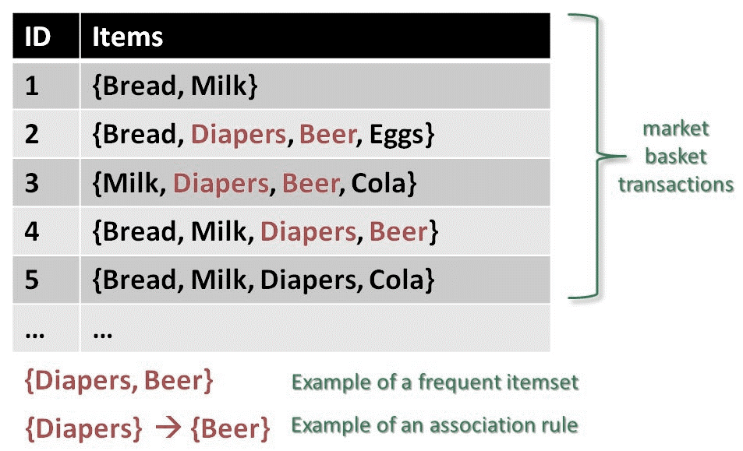
What Kinds of Patterns Can Be Mined? (Cont..)
Mining Frequent Patterns:
Frequent patterns are those patterns that occur frequently in data. Here is the list of kind of frequent patterns
Frequent Item Set
It refers to a set of items that frequently appear together, for example, milk and bread.
Frequent Subsequence
A sequence of patterns that occur frequently such as purchasing a laptop is followed by digital camera and a memory card.
Frequent Sub Structure
A substructure can refer to different structural forms (e.g., graphs, trees, or lattices) that may be combined with itemset or subsequence's.

Slide 18
What Kinds of Patterns Can Be Mined? (Cont..)
Association analysis:
the process of uncovering the relationship among data and determining association rules.
It is used to discover interesting relationships and associations among items or events in large datasets.
Example
Suppose we have a transactional dataset from a Electronics store, and we want to discover associations between purchased items. Here's a simple example of an association rule generated from the data:
buys(X,“computer”) ⇒ buys(X,“software”) [support = 1%,confidence = 50%],
where X is a variable representing a customer.
A confidence, or certainty, of 50% means that if a customer buys a computer, there is a 50% chance that she will buy software as well.
A 1% support means that 1% of all the transactions under analysis show that computer and software are purchased together.

Slide 19
What Kinds of Patterns Can Be Mined? (Cont..)
Mining of correlations:
it is a data mining technique that aims to identify the statistical relationships or associations between variables in a dataset.
It measures the strength and direction of the linear relationship between two or more variables that if they have positive, negative or no effect on each other.
Example:
Correlation between TV Advertising and Sales: +0.95 (approximate)
Correlation between Radio Advertising and Sales: +0.85 (approximate)
Correlation between Online Advertising and Sales: +0.90 (approximate)

Slide 20
What Kinds of Patterns Can Be Mined? (Cont..)
Classification and Regression for Predictive Analysis :
Classification is the process of finding a model (or function) that describes and distinguishes data classes or concepts.
The model are derived based on the analysis of a set of training data (i.e., data objects for which the class labels are known).
How is the derived model presented?
Classification (IF-THEN) Rules
Decision Trees
Mathematical Formulae
Neural Networks
Classification
It predicts the class of objects whose class label is unknown.
The Derived Model is based on the analysis set of training data i.e. the data object whose class label is well known.
Example:Consider a scenario where you receive a large volume of emails, and you want to automatically classify them as spam or non-spam.

Slide 21
What Kinds of Patterns Can Be Mined? (Cont..)
Classification and Regression for Predictive Analysis (Cont..) :
Prediction
It is used to predict missing or unavailable numerical data values rather than class labels.
Regression Analysis is generally used for prediction.
Example: Let's consider a scenario where you want to predict the price of a house based on its size (in square feet).
Cluster Analysis
clustering analyzes data objects without consulting class labels.
In many cases, class- labeled data may simply not exist at the beginning
Clustering can be used to generate class labels for a group of data.
The objects are clustered or grouped based on the principle of maximizing the intraclass similarity and minimizing the interclass similarity.
That is, clusters of objects are formed so that objects within a cluster have high similarity in comparison to one another, but are rather dissimilar to objects in other clusters.

Slide 22
What Kinds of Patterns Can Be Mined? (Cont..)
Classification and Regression for Predictive Analysis (Cont..) :
Example: Imagine you have a customer database containing various attributes such as age, income, and purchasing behavior. By applying clustering algorithms to this data, you can identify distinct groups or segments of customers with similar characteristics and behaviors.
Outlier Analysis
A data set may contain objects that do not comply with the general behavior or model of the data.
These data objects are outliers.
Many data mining methods discard outliers as noise or exceptions.
Example: Consider a dataset that records the attendance of students in a class over a semester. By examining the dataset, we notice that the some data points is significantly lower than the attendance values of the other students.

Slide 23
Are All Patterns Interesting?
A data mining system has the potential to generate thousands or even millions of patterns, or rules.
Typically, the answer is no.
techniques for evaluating and selecting interesting patterns:
Objective Measures of Interestingness:
Objective measures quantify the quality or interestingness of patterns based on statistical significance or measures derived from the data.
These measures include support, confidence, lift, and various statistical tests.
Subjective Measures of Interestingness:
Subjective measures take into account the user's preferences, domain knowledge, and specific application requirements.
Users can specify interestingness thresholds or define constraints to filter and focus
on patterns that meet their criteria.

Slide 24
Which Technologies Are Used?
Data mining has incorporated many techniques from other domains such as statistics, machine learning, pattern recognition, database and data warehouse systems, information retrieval, visualization, algorithms, high performance computing, and many application domains
Statistics:
A statistical model is a mathematical representation or description of the relationship between variables in a dataset.
It consists of a set of mathematical functions or equations that define the behavior of the objects.
It provides methods and techniques for summarizing and understanding numerical information and making predictions based on data.
Machine Learning:
It enable computers to learn and make predictions or decisions without being explicitly programmed.
it is concerned with creating systems that can automatically learn and improve from experience or data.
Supervised learning:
is basically a synonym for classification. The supervision in the learning comes from the
labeled examples in the training data set.

Slide 25
Which Technologies Are Used? (Cont..)
Machine Learning:
Unsupervised learning
is Unsupervised learning is essentially a synonym for clustering. The learning process is unsupervised since the input examples are not class labeled.
Semi-supervised learning
Semi-supervised learning is a class of machine learning techniques that make use of both labeled and unlabeled examples when learning a model.
Active learning
Active learning is a machine learning approach that lets users play an active role in the learning process. An active learning approach can ask a user (e.g., a domain expert) to label
Database Systems and Data Warehouses
Many data mining tasks need to handle large data sets or even real-time, fast streaming data. Therefore, data mining can make good use of scalable database technologies to achieve high efficiency and scalability on large data sets.
Recent database systems have built systematic data analysis capabilities on database
data using data warehousing and data mining facilities.

Slide 26
Which Technologies Are Used? (Cont..)
Information Retrieval:
Information retrieval (IR) is the science of searching for documents or information in documents.
Documents can be text or multimedia, and may reside on the Web.
The differences between traditional information retrieval and database systems are
the data under search are unstructured
the queries are formed mainly by keywords, which do not have complex structures

Slide 27
Which Kinds of Applications Are Targeted?
There are a two highly successful and popular application examples of data mining: business intelligence and search engines.
Business Intelligence
Business intelligence (BI) technologies provide historical, current, and predictive views of business operations.
Examples include reporting, online analytical processing, business performance management, competitive intelligence, benchmarking, and predictive analytics.
Without data mining, many businesses may not be able to perform effective market analysis, compare customer feedback on similar products, discover the strengths and weaknesses of their competitors, retain highly valuable customers, and make smart business decisions.
Web search engine
A Web search engine is a specialized computer server that searches for information on the Web.
Web search engines are essentially very large data mining applications. Various data mining techniques are used in all aspects of search engines
Search engines pose grand challenges to data mining.
First, they have to handle a huge and ever-growing amount of data.

Slide 28
Which Kinds of Applications Are Targeted? (Cont..)
. Web search engine
First, they have to handle a huge and ever-growing amount of data.
Second, Web search engines often have to deal with online data. A search engine may be able to afford constructing a model offline on huge data sets.
Another challenge is maintaining and incrementally updating a model on fast- growing data streams.
Third, Web search engines often have to deal with queries that are asked only a very small number of times.

Slide 29
Data Mining Issues
Data mining issues can be classified into five categories:
Mining Methodology
User Interaction
Efficiency and Scalability (Algorithms)
Diversity of Database Types
Data Mining and Society

Slide 30
1. Mining Methodology
Data Mining Issues
Mining various and new kinds of knowledge
Data mining covers a wide spectrum of data analysis and knowledge discovery tasks, so these tasks may use the same database in different ways and requires a development of numerous data mining techniques.
Mining knowledge in multidimensional space
When searching for knowledge in large data sets, we can explore the data in multidimensional space.
That is, we can search for interesting patterns among combinations of dimensions (attributes) at varying levels of abstraction. Such mining is known as (exploratory) multidimensional data mining.
Data mining—an interdisciplinary effort
The power of data mining can be substantially enhanced by integrating new methods from multiple disciplines.
For example, to mine data with natural language text, it makes sense to fuse data mining methods of information retrieval and natural language processing.
Handling uncertainty, noise, or incompleteness of data
Data often contain noise, errors, exceptions, uncertainty or incomplete.
Errors and noise may confuse the data mining process, leading to the derivation
of erroneous patterns.

Slide 31
2. User Interaction
Data Mining Issues
Interactive mining
The data mining process should be highly interactive. Thus, it is important to build flexible user interfaces and an exploratory mining environment, facilitating the user’s interaction with the system.
Incorporation of background knowledge
Background knowledge, constraints, rules, and other information regarding the domain under study should be incorporated into the knowledge discovery process.
Presentation and visualization of data mining results
How any system can present data mining results, vividly(clear image in mind) and flexibly ?, so that the discovered knowledge can be easily understood and directly usable by humans.

Slide 32
3. Efficiency and Scalability
Data Mining Issues
Efficiency and scalability of data mining algorithms
Data mining algorithms must be efficient and scalable in order to effectively extract information from huge amounts of data lies in many data repositories or in dynamic data streams.
In other words, the running time of a data mining algorithm must be predictable, short, and acceptable by applications.
Efficiency, scalability, performance, optimization and the ability to execute in real time are key criteria for new mining algorithms.
Parallel, distributed, and incremental mining algorithms
The giant size of many data sets, the wide distribution of data, and the computational complexity of some data mining methods are factors that motivate the development of parallel and distributed data-intensive mining algorithms.

Slide 33
4. Diversity of Database Types
Data Mining Issues
Handling complex types of data
Data mining is how to uncover knowledge from stream, time-series, sequence, graph, social network and multi-relational data.
In mining various types of attributes are available and also different types of data in database or dataset.
Mining dynamic, networked, and global data repositories
Data from multiple sources are connected by the Internet and various kinds of networks like distributed and heterogeneous global information systems.
The discovery of knowledge from different sources of structured, semi-structured, or unstructured is challengeable.

Slide 34
5. Data Mining and Society
Data Mining Issues
Social impacts of data mining
With data mining penetrating our everyday lives, it is important to study the impact of data mining on society,
How can we used at a mining technology to benefit our society?
How can we guard against its misuse?
Privacy-preserving data mining
Data mining will help in scientific discovery, business management, economy recovery, and security protection (e.g., the real-time discovery of intruders and cyber attacks).
However, it poses the risk of disclosing an individual’s personal information.
Invisible data mining
We cannot expect everyone in society to learn and master in data mining techniques.
For example, when purchasing items online, users may be unaware that the store is likely collecting data on the buying patterns of its customers, which may be used to recommend other items for purchase in the future.

Slide 35
What is an Attribute?
The attribute can be defined as a field for storing the data that represents the characteristics of a data object.
It can also be viewed as a property, characteristics, feature or column of a data object.
The nouns attribute, dimension, feature, and variable are often used interchangeably in the literature.
It represents the different features of an object (real world entity) like..
👨 Person → Name, Age, Qualification, Birthdate etc.
💻 Computer → Brand, Model, Processor, RAM etc.
📚 Book → Book Name, Author, Price, ISBN etc.
An attribute set defines an object.
The object is also referred to as a record of the instances or entity.

Slide 36
Attribute Types
Attribute types can be divided into mainly two categories.
Quantitative
Discrete
Continuous
Qualitative
Nominal
Ordinal
Binary
Symmetric
Asymmetric
Quantitative
Discreate
Continuous
Qualitative
Nominal
Ordinal
Binary
Symmetric
Asymmetric

Slide 37
1. Quantitative Attribute
Attribute Types
Quantitative is an adjective that simply means something that can be measured.
It is a special attribute that is used to compare two values, i.e., it is used to compare a user-defined value against an upper limit and a lower limit.
Example
We can count the number of sheep on a farm or measure the liters of milk produced by a cow.
Consider a query to find all patients with low or high blood glucose levels. In database, for each patient a lower value and an upper value for blood glucose level is stored in the Result class.
To find patients with low/high level of blood glucose, without QA you would have to specify a limit on the Low attribute or the High attribute of the Result class.
While defining limit you can use Between, Equals, Less than, Less than or Equal to, Greater than, Greater than or Equal as relational operators.

Slide 38
1. Quantitative Attribute
Attribute Types
1) Discrete Attribute
A discrete attribute has a finite or countably infinite set of values, which may or may not be represented as integers.
The attributes hair_color, smoker, medical_test, and drink_size each have a finite number of values, and so are discrete.
CustomerID in a table has countably infinite set of values because over a time period it grows.
2) Continues Attribute
Real numbers as attribute values.
The attributes temperature, height, or weight are the examples of continuous attributes.
Practically, real values can only be measured and represented using a finite number of digits.
Continuous attributes are typically represented as floating- point variables.

Slide 39
2. Qualitative Attribute
Attribute Types
Qualitative data deals with characteristics and descriptors that can't be easily measured, but can be observed subjectively—such as smells, tastes, textures, attractiveness, and color.
Simple arithmetic attributes that is named or described in words.
It is represented in integer or real values.
Results of qualitative attribute are often quoted on scales.
Below are the qualitative Attributes.
Nominal
Ordinal
Binary
Symmetric
Asymmetric

Slide 40
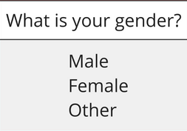
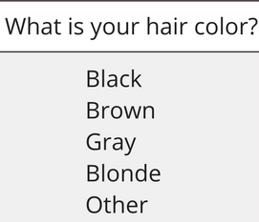
2. Qualitative Attribute Cont..
Attribute Types
1) Nominal Attribute
Nominal attributes are named attributes which can be separated into discrete (individual) categories which do not overlap.
Nominal attributes values also called as distinct values.
Example

Slide 41
2. Qualitative Attribute Cont..
Attribute Types
2) Ordinal Attribute
Ordinal attribute is the order of the values, that’s important and significant, but the differences between each one is not really known.
Example
Rankings → 1st, 2nd, 3rd
Ratings →
We know that a 5 star is better than a 2 star or 3 star, but we don’t know and cannot quantify–how much better it is?
3) Binary Attribute
Binary attributes are the categorical attributes with only two possible values (yes or no), (true or false), (0 or 1).
Symmetric binary attribute is the attribute which each value is equally valuable (male or female). The male here is not more important than the female value.
Asymmetric is the attribute which the two states is not equally important, for example, the medical test (positive or negative), here, the positive results is more significant than the negative one.
,

Slide 42
Extra
Attribute Types
Interval Attribute
Interval attribute comes in the form of a numerical value where the difference between points is meaningful.
Example
Temperature → 10°-20°, 30°-50°, 35°-45°
Calendar Dates → 15th – 22nd, 10th – 30th
We can not find true zero (absolute) value with interval attributes.
Ratio Attribute
Ratio attribute is looks like interval attribute, but it must have a true zero (absolute) value.
It tells us about the order and the exact value between units or data.
Example
Age Group → 10-20, 30-50, 35-45 (In years)
Mass → 20-30 kg, 10-15 kg
It does have a true zero (absolute) so, it is possible to compute ratios.

Slide 43
Mean (Average)
Mean is the average of a dataset
Mean is the average of a dataset.
The mean is the total of all the values, divided by the number of values.
Formula to find mean
Example
Find out mean for 12, 15, 11, 11, 7, 13 (Here total data is = 6)
$$\overline{X} =\frac{1}{n}\sum_{i=1}^{n}{x}$$
First, find the sum of the data.
12 + 15 +11 + 11 + 7 + 13 = 69
Then divide by the total number of data.
69 / 6 = 11.5
(Mean)

Slide 44
Median {Centre Or Middle Value}
The median is the middle number in a list of numbers ordered from lowest to highest.
Example
Find out Median for 12, 15, 11, 11, 7, 13, 15 (Here total data is = 7 {odd})
If count is Odd then middle number is Median
First, arrange the data in ascending order.
7, 11, 11, 12, 13, 15, 15
Partitioning data into equal half's
7, 11, 11, 12, 13, 15, 15
12 Median

Slide 45

Median {Centre Or Middle Value} (Cont..)
If count is Even then take average (mean) of middle two numbers that is Median
Example
Find out Median for 12, 15, 11, 11, 7, 13 (Here total data is = 6 {even})
First, arrange the data in ascending order.
7, 11, 11, 12, 13, 15
Calculate an average (mean) of the two numbers in the middle.
7, 11, 11, 12, 13, 15
(11 + 12)/2 = 11.5 Median

Slide 46
Mode
The mode is the number that occurs most often within a set of numbers.
Example
If more than three numbers repeats within a set of numbers then it is called as multimodal.
12, 15, 11, 11, 7, 13
12, 12 15, 11, 11, 7, 13, 7
11 Mode (Unimodal)
7, 11, 12 Mode (Trimodal)
12, 15, 11, 11, 7, 12, 13
12, 15, 11, 10, 7, 14, 13
11, 12 Mode (Bimodal)
No Mode

Slide 47
Range
The range of a set of data is the difference between the largest and the smallest number in the set.
Example
Find the range for given data 40, 30, 43, 48, 26, 50, 55, 40, 34, 42, 47, 50
In our example largest number is 55, and subtract the smallest number is 26.
First, arrange the data in ascending order.
26, 30, 34, 40, 40, 42, 43, 47, 48, 50, 50, 55
55 – 26 = 29 Range

Slide 48
Standard Deviation (σ)
The Standard Deviation is a measure of how numbers are spread out.
Its symbol is σ (the Greek letter sigma)
In statistics, the standard deviation is a measure of the amount of variation or dispersion of a set of values.
A low standard deviation indicates that the values tend to be close to the mean of the set, while a high standard deviation indicates that the values are spread out over a wider range.
Formula to find standard deviation σ = $\sqrt{\frac{1}{n−1}\sum_{i=1}^{n}{\left(X −Mean\right)}\text{2}}$

Slide 49
Standard Deviation (σ) Cont..
Standard Deviation is Square root of sample variance.
The Variance is defined as:
The average of the squared differences from the Mean.
To calculate the variance follow these steps:
Calculate the mean, $\overline{x}$.
Write a table that subtracts the mean from each observed value.
Square each of the differences, add this column in table.
Divide by n -1 where n is the number of items in the sample, this is the variance (In actual case take n).
To get the standard deviation we take the square root of the variance.

Slide 50
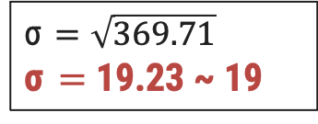
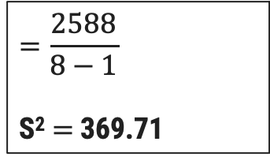
Standard Deviation (σ) Cont..
The owner of the Indian restaurant is interested in how much people spend at the restaurant.
He examines 8 randomly selected receipts for parties and writes down the following data.
44, 50, 38, 96, 42, 47, 40, 39
Find out Mean (Mean is 49.5 for given data)
Write a table that subtracts the mean from each observed value. (2nd step)
σ = $\sqrt{\frac{1}{n−1}\sum_{i=1}^{n}{\left(X −Mean\right)}\text{2}}$
Step : 3
X | X - Mean | Value | (X – Mean)²
44 | 44 - 49.5 | -5.5 | 30.25
50 | 50 - 49.5 | 0.5 | 0.25
38 | 38 - 49.5 | 11.5 | 132.25
96 | 96 - 49.5 | 46.5 | 2162.25
42 | 42 - 49.5 | -7.5 | 56.25
47 | 47 - 49.5 | -2.5 | 6.25
40 | 40 - 49.5 | -9.5 | 90.25
39 | 39 - 49.5 | -10.5 | 110.25
Total |  |  | 2588
Step : 4
$$=\frac{2588}{8−1}$$
S² $=$369.71
Step : 5
σ $=\sqrt{369.71}$
σ $=$ 19.23 ~ 19

Slide 51
Symmetric vs Skewed Data
Mode mean
Mean Mode
Mean, Median, Mode
Median
Median
Symmetric
Positively Skewed
Negatively Skewed

Slide 52
Quantiles
Quantiles are statistical measures that divide a dataset into equal-sized groups.
Providing information about the distribution of the data.
Quantiles are points taken at regular intervals of a data distribution, dividing it into essentially equal- size consecutive sets.
The 2-quantile is the data point dividing the lower and upper halves of the data distribution.
It corresponds to the median.
The 4-quantiles are the three data points that split the data distribution into four equal parts each part represents one-fourth of the data distribution.
They are more commonly referred to as quartiles.
The 100-quantiles are more commonly referred to as percentiles.

Slide 53
Quantiles
25%
Q1
Q2
Q3
25th
Percentile
Median
75th
Percentile
First Quartile (Q1) or 25th Percentile: Q1 is the value below which 25% of the data falls. This means that 25% of the data points in the dataset are less than or equal to Q1.
Second Quartile (Q2) or Median or 50th Percentile: Q2 is the value that separates the dataset into two equal halves.
Third Quartile (Q3) or 75th Percentile: Q3 is the value below which 75% of the data falls. This means that 75% of the data points in the dataset are less than or equal to Q3.

Slide 54
Quantiles
The distance between the first and third quartiles is a called the interquartile range (IQR) and is defined as IQR = Q3 − Q1.

Slide 55
Five-Number Summary
The five-number summary of a distribution consists of the median (Q2), the quartiles Q1 and Q3, and the smallest and largest individual observations, written in the order of Minimum, Q1, Median, Q3, Maximum.
Boxplots are a popular way of visualizing a distribution.

Slide 56
Boxplots
Boxplots provide a means of depicting groups of numbers through their quartiles.
Quartiles means three points dividing a group into four equal parts.
In boxplot, data will be divided in 4 part using the 3 points (25th percentile, median, 75th percentile)
Interquartile Range
(IQR)
Outliers
Whiskers
Whiskers
Outliers
Minimum
(Q1 – 1.5 * IQR)
Maximum
(Q3 + 1.5 * IQR)
Median
Q1
(25th Percentile)
Q2
(50th Percentile)
Q3
(75th Percentile)
-5
-4
-3
-2
-1
0
1
2
3
4
5

Slide 57
Data Matrix vs Dissimilarity Matrix
Data Matrix:
A data matrix, also known as a feature matrix or attribute matrix, is a structured representation of a dataset where rows represent observations or data points, and columns represent attributes or variables.
Each cell in the matrix contains the value of a specific attribute for a particular data point.
A data matrix is made up of two entities or “things,” namely rows (for objects) and columns (for attributes). Therefore, the data matrix is often called a two-mode matrix.
Dissimilarity Matrix :
A dissimilarity matrix, also known as a distance matrix or dissimilarity matrix, is a square matrix that quantifies the dissimilarity or distance between pairs of data points in a dataset.
Each cell in the matrix represents the dissimilarity measure between two data points.
The dissimilarity matrix contains one kind of entity (dissimilarities) and so is called a one-mode matrix.

Slide 58
Data Matrix vs Dissimilarity Matrix
Student_id | Name | Gender
1 | ABC | Male
2 | XYZ | Female
3 | PQR | Male
 | A | B | C
A | 0.0 | 3.2 | 5.3
B | 3.2 | 0.0 | 4.3
C | 5.3 | 4.3 | 0.0
Data Matrix
Dissimilarity Matrix

Slide 59
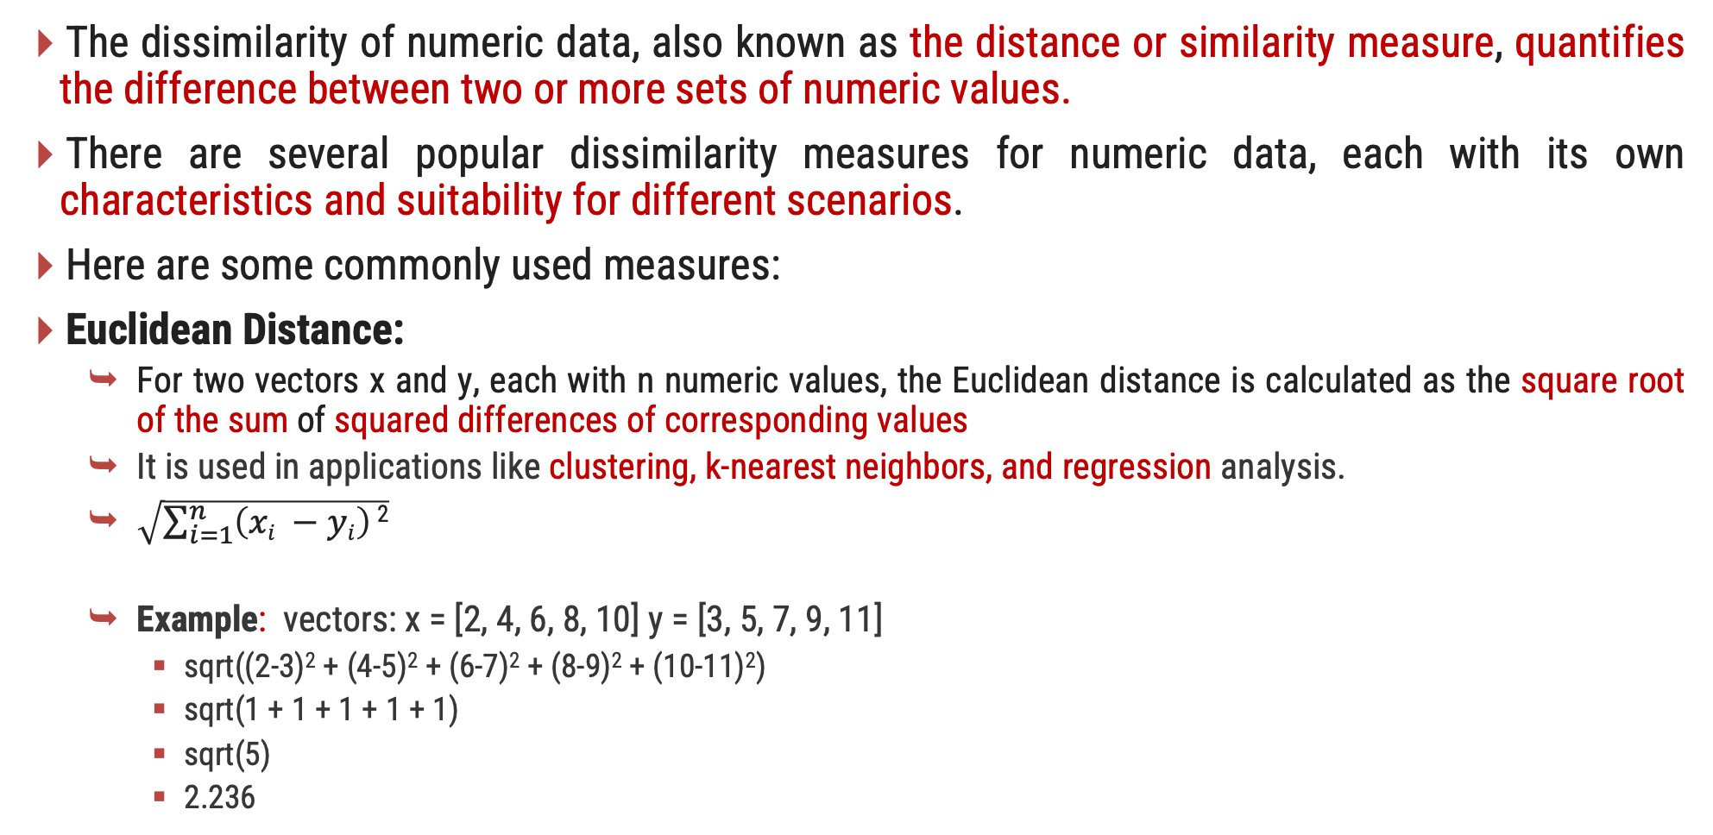
Dissimilarity of Numeric Data
The dissimilarity of numeric data, also known as the distance or similarity measure, quantifies the difference between two or more sets of numeric values.
There are several popular dissimilarity measures for numeric data, each with its own characteristics and suitability for different scenarios.
Here are some commonly used measures:
Euclidean Distance:
For two vectors x and y, each with n numeric values, the Euclidean distance is calculated as the square root of the sum of squared differences of corresponding values
It is used in applications like clustering, k-nearest neighbors, and regression analysis.
$\sqrt{\sum_{i=1}^{n}{\left(xi −yi\right)}\text{2}}$
Example: vectors: x = [2, 4, 6, 8, 10] y = [3, 5, 7, 9, 11]
sqrt((2-3)² + (4-5)² + (6-7)² + (8-9)² + (10-11)²)
sqrt(1 + 1 + 1 + 1 + 1)
sqrt(5)
2.236

Slide 60
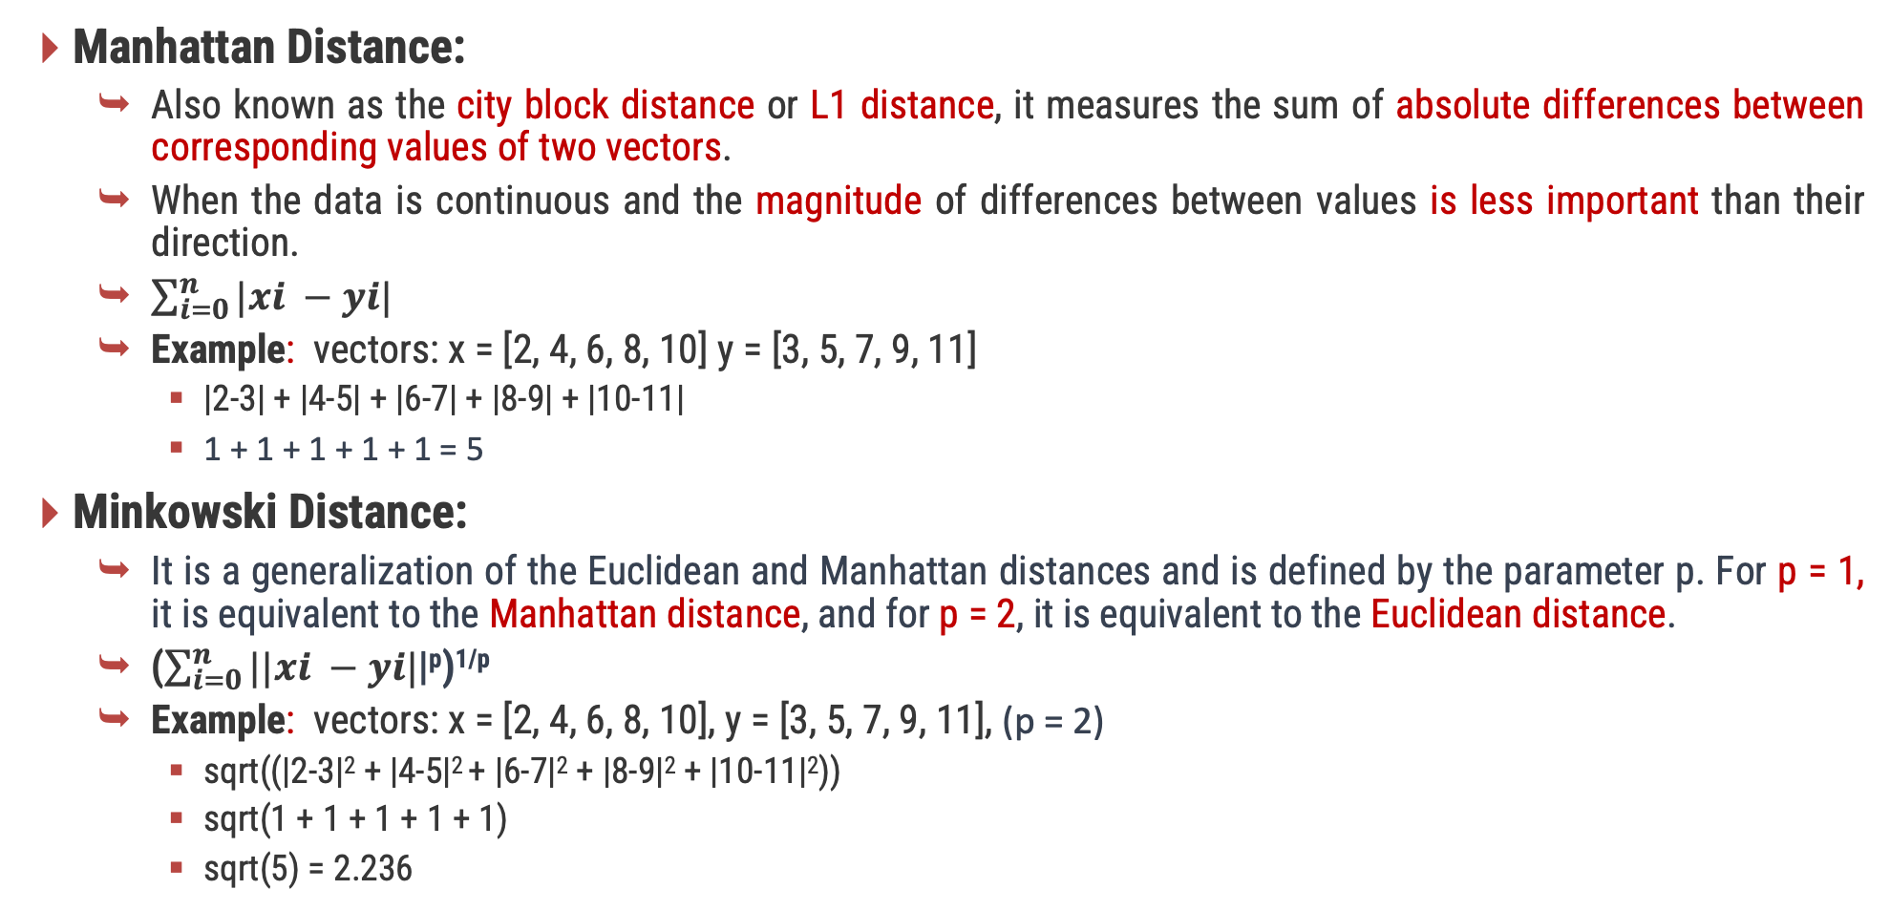
Dissimilarity of Numeric Data
Manhattan Distance:
Also known as the city block distance or L1 distance, it measures the sum of absolute differences between corresponding values of two vectors.
When the data is continuous and the magnitude of differences between values is less important than their direction.
$\sum_{i=0}^{n}{|xi −yi|}$
Example: vectors: x = [2, 4, 6, 8, 10] y = [3, 5, 7, 9, 11]
|2-3| + |4-5| + |6-7| + |8-9| + |10-11|
1 + 1 + 1 + 1 + 1 = 5
Minkowski Distance:
It is a generalization of the Euclidean and Manhattan distances and is defined by the parameter p. For p = 1, it is equivalent to the Manhattan distance, and for p = 2, it is equivalent to the Euclidean distance.
($\sum_{i=0}^{n}{||xi −yi|}$|^{p})^{1/p}
Example: vectors: x = [2, 4, 6, 8, 10], y = [3, 5, 7, 9, 11], (p = 2)
sqrt((|2-3|² + |4-5|² + |6-7|² + |8-9|² + |10-11|²))
sqrt(1 + 1 + 1 + 1 + 1)
sqrt(5) = 2.236

Slide 61
Dissimilarity of Numeric Data
Supremum Distance:
It will measure the maximum absolute difference between corresponding elements of two vectors.
it calculates the largest absolute difference among the corresponding values.
Example: vectors: x = [22, 1, 42, 10] y = [20, 0, 36, 8]
max(|22-20|, |1-0|, |42-36|, |10-8|)
max(2, 1, 6, 2)
6

Slide 62
Exercise
Given two objects represented by the tuples (22, 1, 42, 10) and (20, 0, 36, 8):
(a) Compute the Euclidean distance between the two objects.
(b) Compute the Manhattan distance between the two objects.
(c) Compute the Minkowski distance between the two objects, using q = 3.
(d) Compute the supremum distance between the two objects.
So, the dissimilarity measures for the given objects are:
(a) Euclidean Distance ≈ 6.708
(b) Manhattan Distance = 11
(c) Minkowski Distance (q = 3) ≈ 6.118
(d) Supremum Distance = 6

Slide 63
IMP Questions
Explain KDD Process with diagram.
Explain types of Attributes with example.
What Kinds of Patterns Can Be Mined?
Are All Patterns Interesting?
Explain Data Mining Issues
Explain mean, median, mode, range and standard deviation with example.
Explain five numbers summary with Boxplot diagram.
Explain Data Matrix vs Dissimilarity Matrix.
Explain methods to find dissimilarity of Numeric Data with example.

